Slide 1

Zomato Bengaluru Restaurants

Slide 2
Content
Introduction
Problem definition
EDA with Visualization
Evaluation of machine learning
Summary

Slide 3
Introduction
Zomato is an Indian food delivery startup restaurant aggregator. It primarily provides concrete information, menus, and user reviews of the restaurants. Along with this, Zomato also has food delivery options from partnered restaurants in the selected cities.

Slide 4
Problem Definition
Difficulty for new restaurants to compete with already established restaurants
Zomato is aiming to solve this through:
analyzing the demography of the location. Most importantly it will help new restaurants in deciding their theme, menus, cuisine, cost etc. for a particular location.
finding similarity between neighborhoods of Bengaluru based on food.

Slide 5
EDA with Visualization
“Exploratory Data Analysis refers to the critical process of performing initial investigations on data so as to discover patter, to spot anomalies, to test hypothesis and to check assumptions with the help of summary statistic and graphical representation
For this project we employed python as an environment for all programming and execution needs
Python packages used was:
Pandas – numpy – Matplotlib – seaborn – Sklearn - Folium - geopy

Slide 6
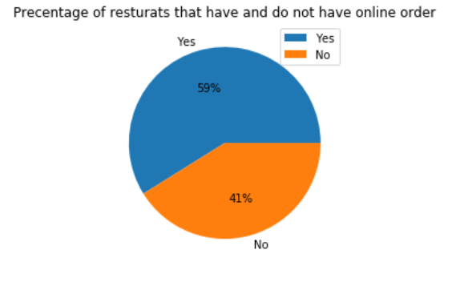
EDA with Visualization
1- How many restaurant accept online orders ?
- Only 59% from the restaurant has online orders

Slide 7
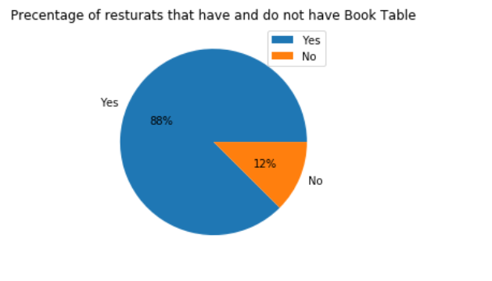
EDA with Visualization
2- How many restaurant have book table?
- Most of the restaurants have a book table

Slide 8
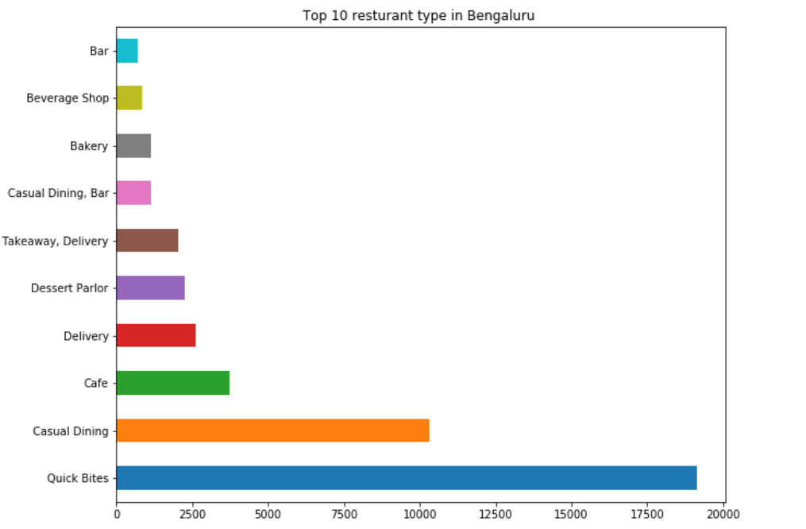
EDA with Visualization
3- Which type of restaurants are from the top ten in Bengaluru?
There are 93 different type of restaurants
People in Bengaluru prefer Quick Bites's restaurant type
Quick Bite and Casual Dinning are the most dominate
type of restaurant

Slide 9
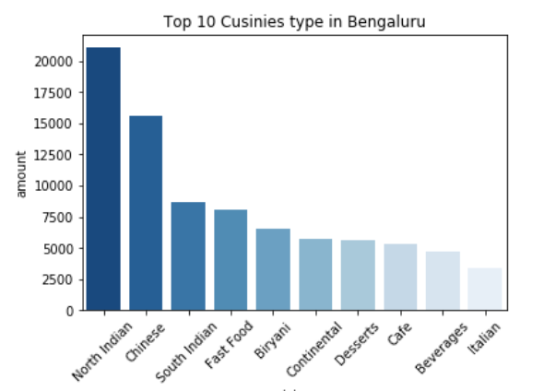
EDA with Visualization
4- What are the main cuisine types available in Bengaluru ?
- “North Indian's Cuisine” is the most common type in Bengaluru

Slide 10
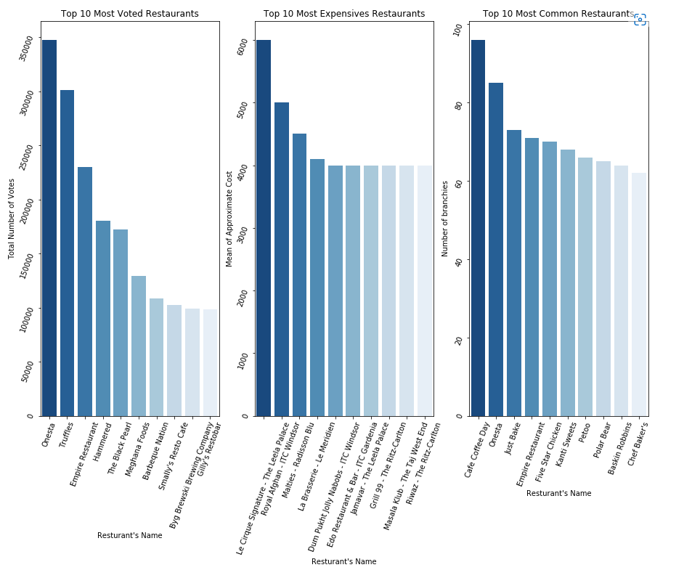
EDA with Visualization
6- What are the most popular restaurants ?
- Here Most popular restaurants were select
based on the votes, cost and max branches
- Onseta was the most voted
- Le Cirque Signature - The Leela Palace was the most
expensive cost
- Cafe Coffee Day have the highest number of branches

Slide 11
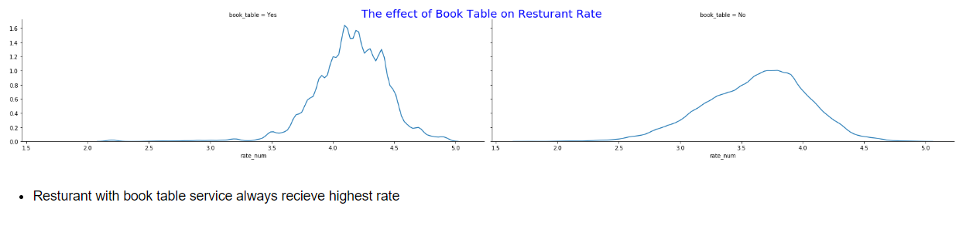
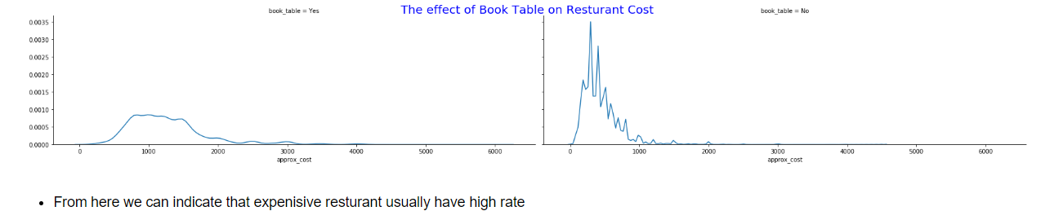
EDA with Visualization
7- What is the effect of Book table on rate and cost ?

Slide 12
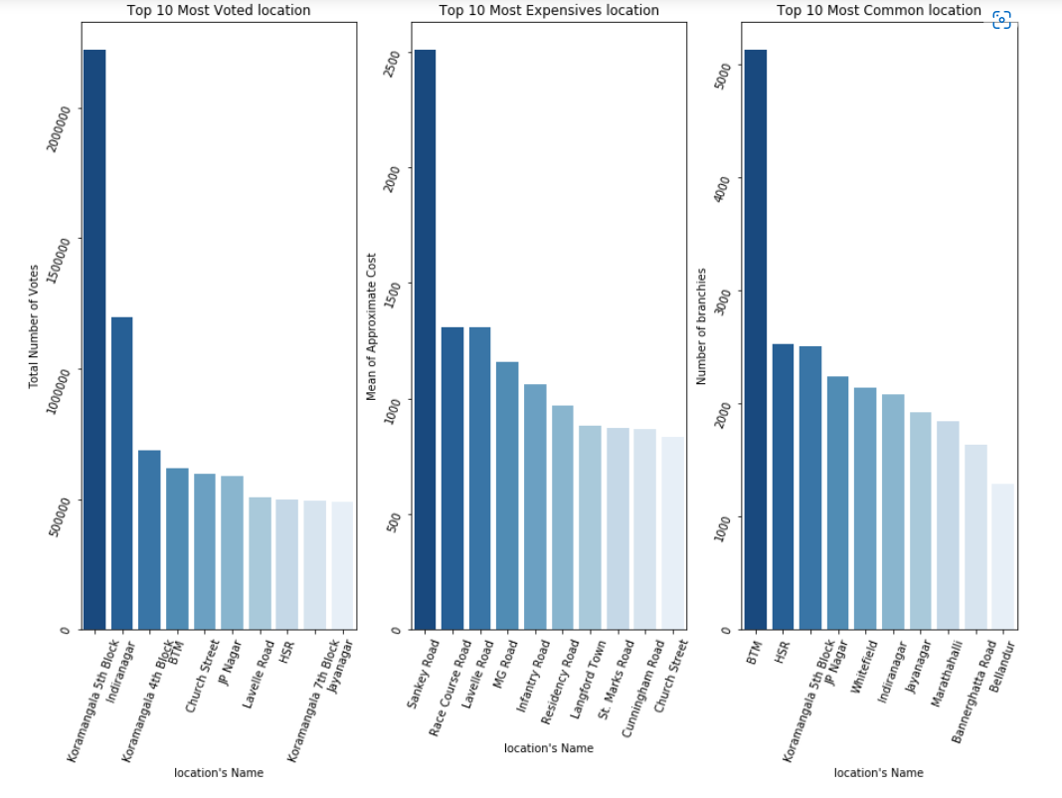
EDA with Visualization
8- Where are the best restaurants ?
Here Most popular location for restaurants
were select based on the votes, cost and
most repeated places
- Koramangala 5th Block* was the most voted
- Sankey Road was the most expensive cost
- BTM have the highest repeated place

Slide 13
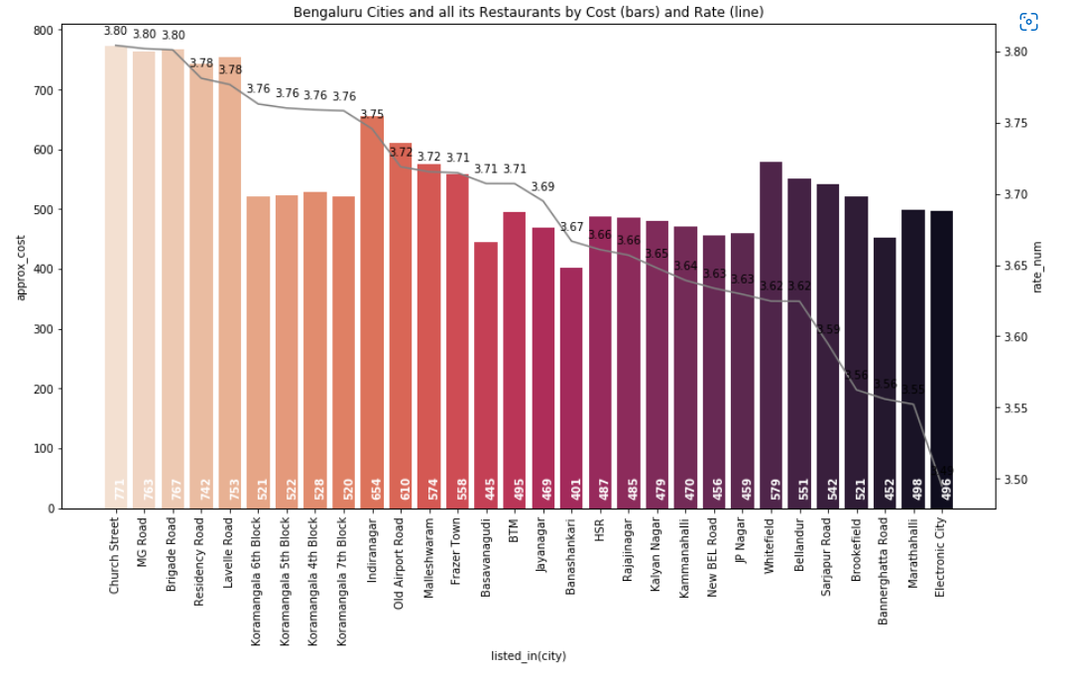
EDA with Visualization
9- How are rate and cost affect on choosing best city to eat in it ?

Slide 14
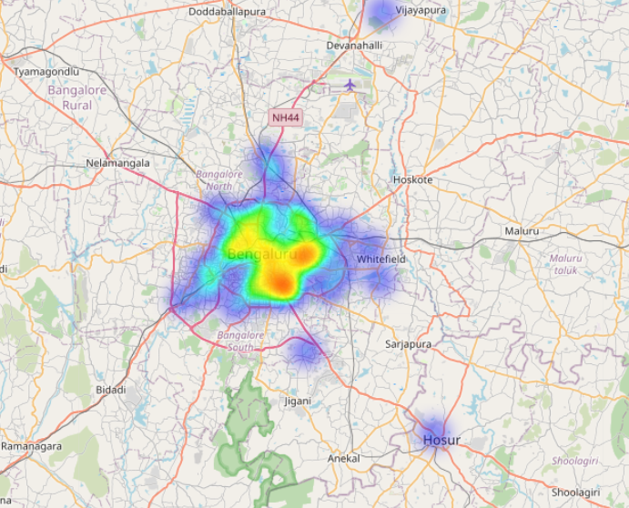
EDA with Visualization
10- Heatmap of restaurant count on each location

Slide 15
Evaluation of machine learning
Best model was selected for machine learning is Extra tree classifier
For evaluation we depended on many techniques and metrics:
Cross validation
Confusion matrix
Accuracy score
precision, recall, F1-Score
Roc curve , Roc auc score

Slide 16
Evaluation of machine learning
Cross validation
is a technique in which we train our model using the subset of the data-set and then evaluate using the complementary subset of the data-set.
Using 5 –fold with all dataset
We got mean accuracy of 0.93
We used cross_val_score

Slide 17
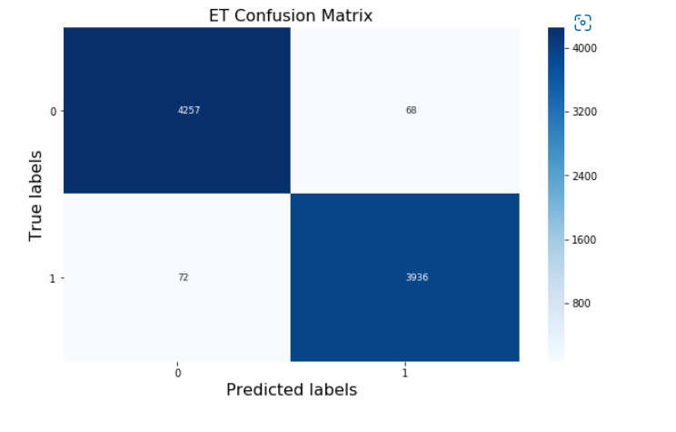
Evaluation of machine learning
Confusion matrix

Slide 18
Evaluation of machine learning
Accuracy score, Precision, Recall and F1 Score
Precision 0.98
Recall 0.98
Accuracy score 0.99
F1 Score 0.99

Slide 19
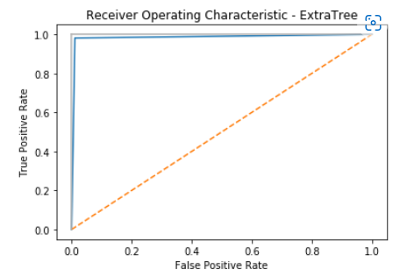
Evaluation of machine learning
ROC Curve , ROC auc score
ROC auc score : 0.99

Slide 20
Summary
Approximate cost and votes are the most Two variables has effect on restaurant successful
Restaurants with Book Table service are more important than Online service and have high rated
The top restaurant type is Quick bites
the most common cuisine is north Indian
The most popular restaurants
Onesta has max vote
Le Cirque Signature - The Leela Palace is The most expensive
Cafe Coffee Day is The most common one
Book table service has an effect on both rate and cost
BTM is the best location to find a restaurant
Koramangala 5th Block is the best location to find most voted restaurants
Sankey Roads the best location Where the most expensive restaurants exists
BTW is the most common location to found a restaurants
Quick Bites is the preferred type in Bengaluru
North Indian cuisine type is the most common one in Bengaluru
For New Restaurants in order to have a good compute with other restaurants
Caring about rate and cost should be top priority
Your restaurant should have a book table and might have online ordering as this increase your rate among the others
You should start in any location of the top 10 common location then after your rating is raised up you could establish a new branch in the top 10 most voted location
Choose type of your restaurant from top ten restaurant and top ten cuisine type in Bengaluru

